Slide 2




Slide 3

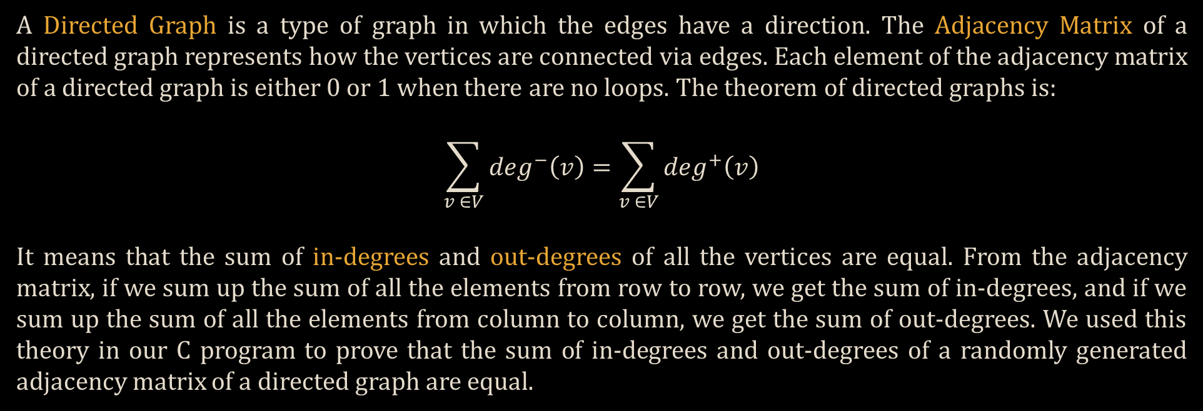
A Directed Graph is a type of graph in which the edges have a direction. The Adjacency Matrix of a directed graph represents how the vertices are connected via edges. Each element of the adjacency matrix of a directed graph is either 0 or 1 when there are no loops. The theorem of directed graphs is:
$$\sum_{v ∈V}{\deg^{−}\left(v\right)}=\sum_{v ∈V}{\deg^{+}\left(v\right)}$$
It means that the sum of in-degrees and out-degrees of all the vertices are equal. From the adjacency matrix, if we sum up the sum of all the elements from row to row, we get the sum of in-degrees, and if we sum up the sum of all the elements from column to column, we get the sum of out-degrees. We used this theory in our C program to prove that the sum of in-degrees and out-degrees of a randomly generated adjacency matrix of a directed graph are equal.

Slide 4


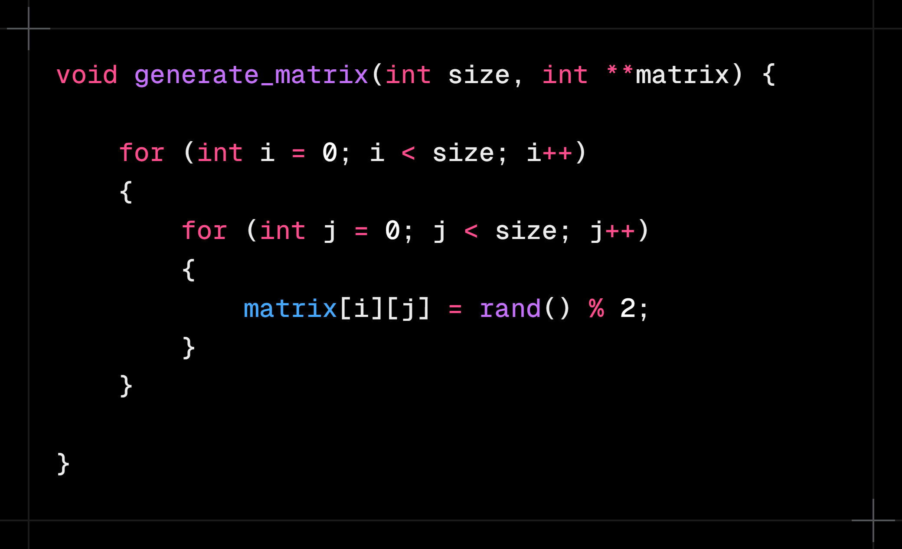
Two function parameters are used, one for the number of vertices which is size and one for the 2D array for the adjacency matrix named matrix, and for the 2D array, double pointer is being used for dynamic memory allocation. Using two for loops, the rows and columns of the matrix are accessed and by using the rand( ) function from stdlib.h, a random number between 0 and 1 is being generated. Thus, the whole matrix of (size x size) is randomly generated.

Slide 5


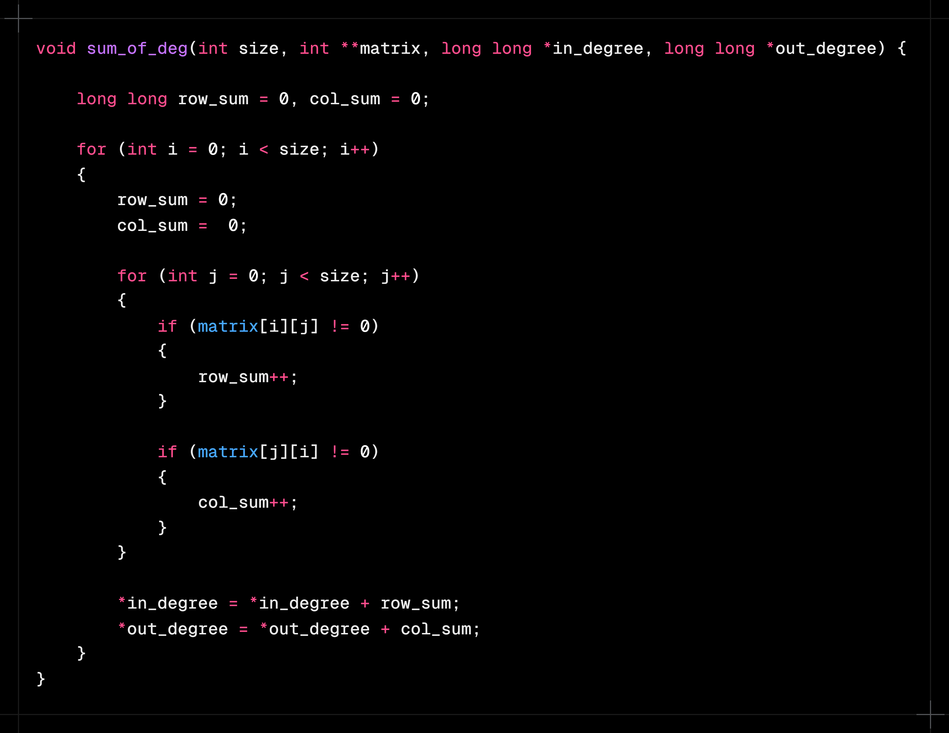
In this function, four parameters are used, for number of vertices, for 2D adjacency matrix using double pointer, for storing sum of in-degrees and for sum of out-degrees. For the sum, long long data type is used since the data can be really big depending the size of the matrix. Two variables are declared with initial value of 0 for storing the sum of degrees of one row and one column. Two for loops are used to access the rows and columns of the matrix, at the start of each iteration of the outer loop, degree sum of row and column is set to 0. For every non-zero element of every row and column, the row_sum and col_sum is incremented by 1. At the end of each iteration of the outer loop, the sums are added to the function arguments using pointers since we cannot return more than one value.

Slide 6


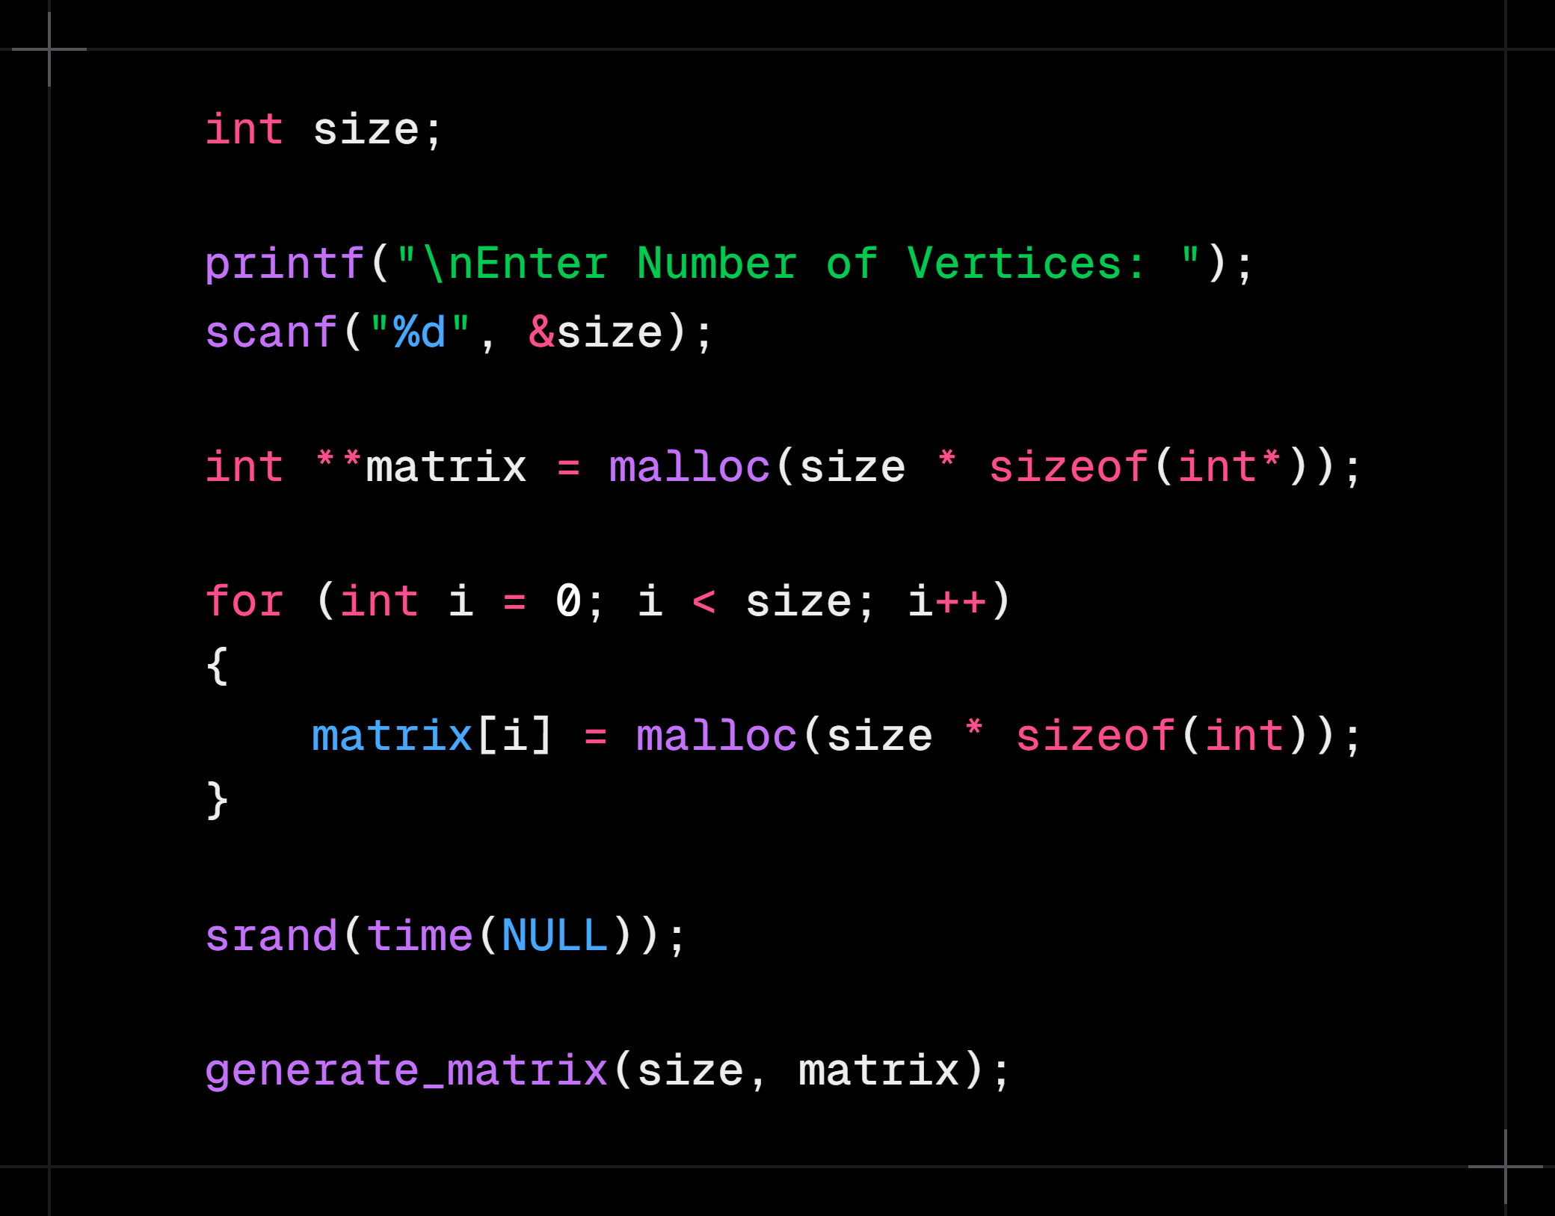
First of all, the number of vertices is declared as size for taking input from the user using scanf( ), it is for making the program dynamic rather than static. Then using double pointer, a 2D array named matrix is declared, and using malloc( ) function from stdlib.h, memory for the 2D array is dynamically stored during runtime. Dynamic memory allocation is used because of the large size of data, which can cause problem in case of static memory allocation during compile time. Before randomly generating the matrix with the generate_matrix( ) function, the random number generator is being seeded using the srand( ) and
time( ) functions from stdlib.h and time.h respectively.

Slide 7
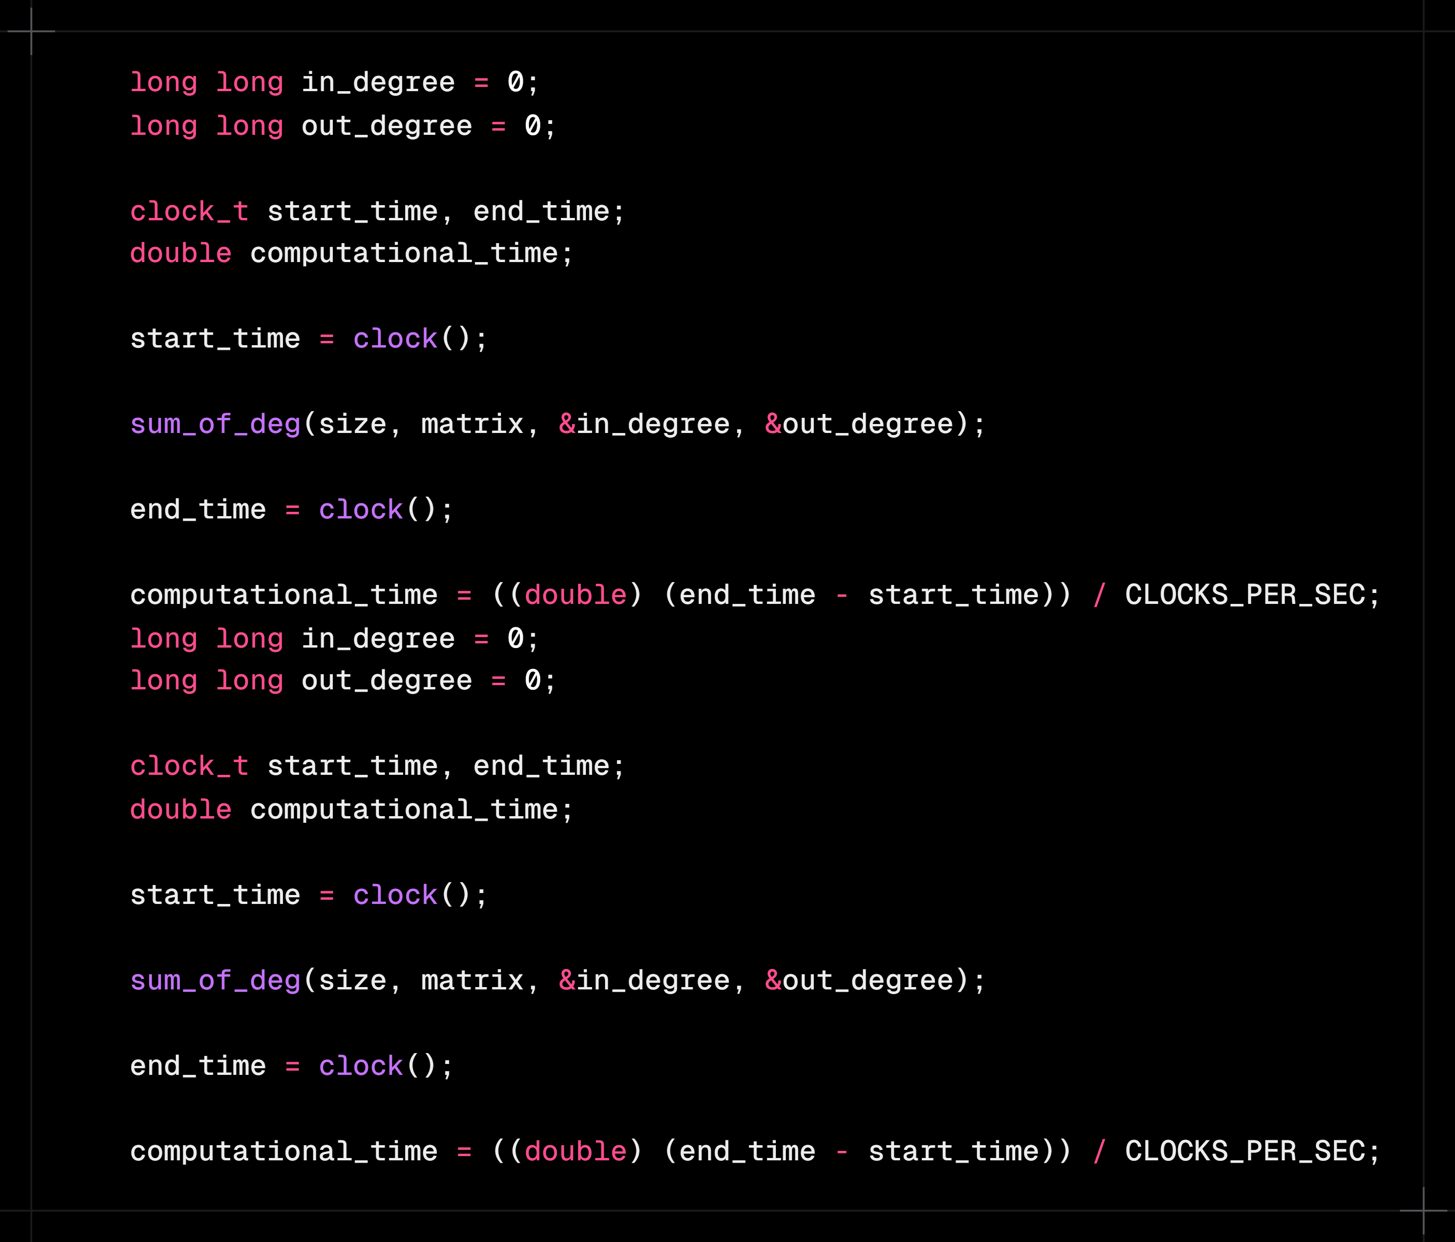
After That, two long long variables are declared with value 0 to store the sum of in-degrees and out-degrees. Two variables of data type clock_t are declared to store the processor time in ticks, one to use before the sum calculating function and one to use immediately after. A double variable is declared to store the computational time in seconds. Then the sum_of_deg( ) function is used for calculating the sums. Before and after this function, the start_time and end_time variable are used using the clock( ) function from time.h to store the processor time in ticks. The computational time is calculated in seconds by dividing the difference between the end and starting time in ticks by the constant from time.h, CLOCKS_PER_SEC, which is the number of ticks per second.

Slide 8
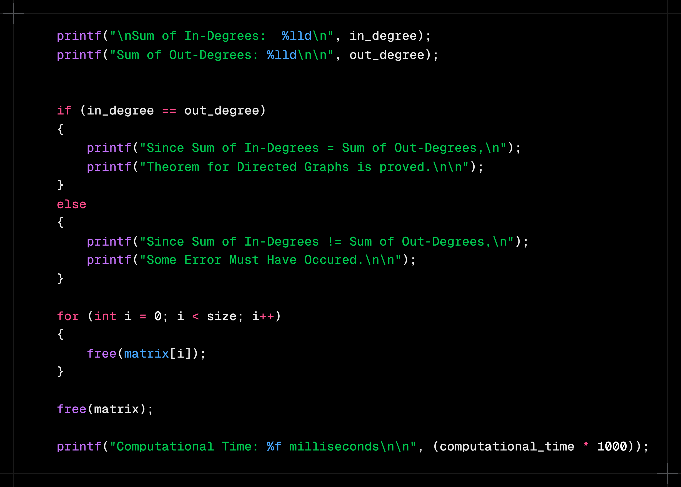
Finally, The results are printed using printf( ), along with the statement that the theorem of directed graphs is proved. Then, the memory allocated for the 2D matrix during runtime is freed using the free( ) function from stdlib.h. At the end, the computational time is printed in milliseconds by multiplying the computational_time variable with 1000.

Slide 9

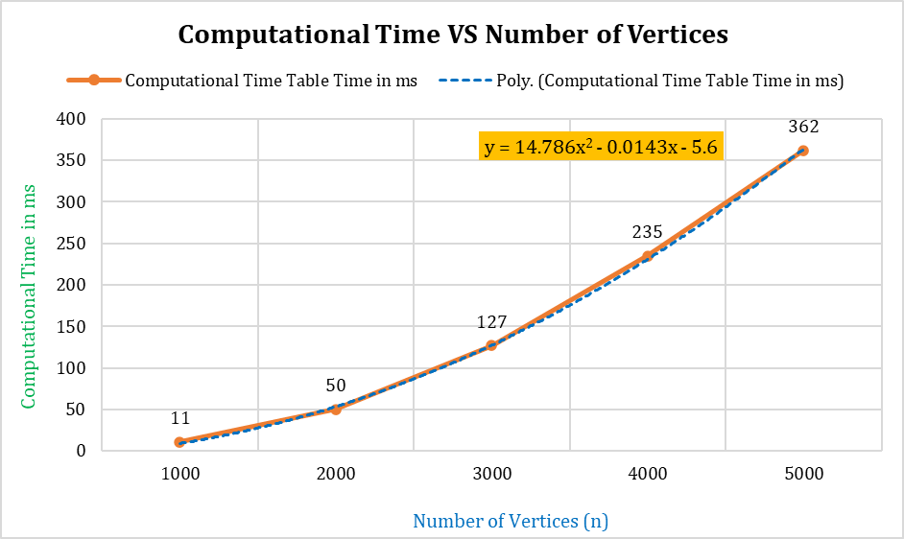
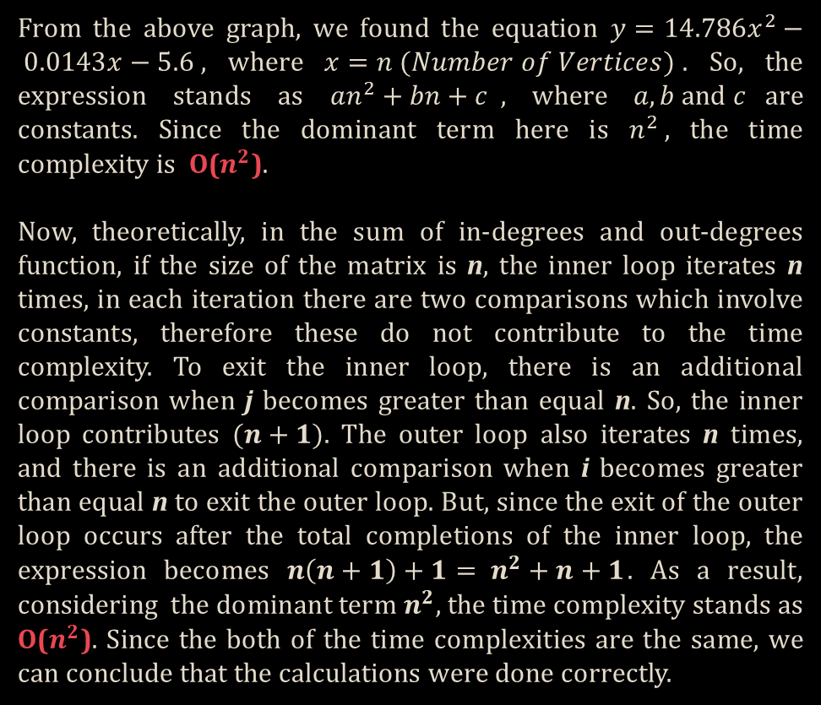
From the above graph, we found the equation $y=14.786x^{2}− 0.0143x−5.6$, where $x=n (Number of Vertices)$. So, the expression stands as $an^{2}+bn+c$, where $a, b and c$are constants. Since the dominant term here is $n^{2}$, the time complexity is O($n^{2}$).
Now, theoretically, in the sum of in-degrees and out-degrees function, if the size of the matrix is n, the inner loop iterates n times, in each iteration there are two comparisons which involve constants, therefore these do not contribute to the time complexity. To exit the inner loop, there is an additional comparison when j becomes greater than equal n. So, the inner loop contributes $(n+1)$. The outer loop also iterates n times, and there is an additional comparison when i becomes greater than equal n to exit the outer loop. But, since the exit of the outer loop occurs after the total completions of the inner loop, the expression becomes $n\left(n+1\right)+1= n^{2}+n+1$. As a result, considering the dominant term $n^{2}$, the time complexity stands as O($n^{2}$). Since the both of the time complexities are the same, we can conclude that the calculations were done correctly.
Graph Chart of CPU Time VS (n)

Slide 10


Slide 11




